Slide 1
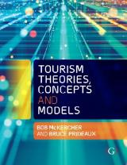

Chapter 11: Sociological and Anthropological Concepts in Tourism

Slide 2
Learning Objectives
Understand tourism as a quest for contrived reality
Evaluate how tourism is a quest for authenticity
Define the environmental bubble and critique how it forms the basis of commercial tourism
Evaluate Cohen’s five roles of tourists
Analyse Cohen’s quest for the other
Assess and be able to critique the concept of liminality
Identify aspects of risk and how they affect travel behaviour

Slide 3
Sociological perspectives on tourism
Boorstin’s essentially negative 1960s view that tourism represents contrived reality
MacCannell’s 1970s more positive view that tourism represents a quest for authenticity
Cohen’s more nuanced views that tourism represents a quest for one’s centre

Slide 4
Boorstin
In the early 1960s, sociologists were becoming increasingly concerned about the contrived and illusory nature of the human experience in American society
Tourism, especially large scale, mass tourism, was seen as being just another example of how American life had become overpowered by pseudo-events and contrived experiences
The modern tourist was simply a passive onlooker who was isolated from the host environment and the local residents
  Tourists chose isolate themselves in tourist ghettos.
  Both the tourist experience and the type of tourism development had become more contrived
  The tourist moved in a closed self-perpetuating environment that was isolated from the rest of the world

Slide 5
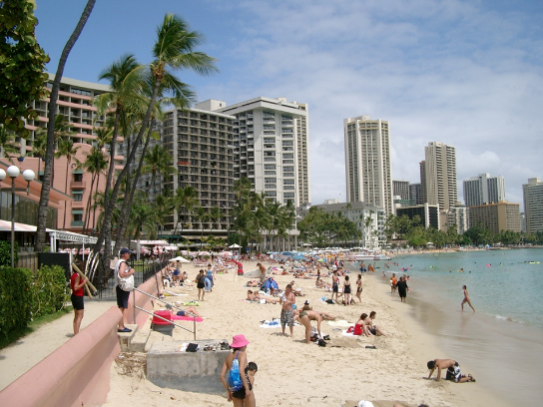
Contributions and limitations of Boorstin
Contributions
  Mass tourists can only withstand a certain amount of strangeness
  The idea of the ‘tourist ghetto’ that is isolated from the real world
  The only types of contact that tourists are likely to have with locals are either in a servant-master relationship, in a commercial relationship, or through the window of a self-enclosed, air conditioned bus
Limitations
  He labels all tourists as being the same
  Work is editorial and observational in nature, rather than scientifically rigorous
Photograph by McKercher

Slide 6
MacCannell (1973) – quest for authenticity
The modern tourist is not a victim of a contrived and illusory culture, but instead is on a quest for authenticity that involves paying homage to the symbols of modernity, in this case tourist attractions
Modern mass tourism journeys share many similarities with religious pilgrimages
Tourist attractions are highly significant social symbols
Quest for authentic tourist attractions becomes the central motivation for tourism
MacCannell (2018) “tourism is a ritual of modern peoples, in which they scour the world looking for some kind of authenticity, a quality which many think is lacking in modern social life; and in this intention they are aided by modern hosts who attempt to ‘stage’ it for them”.

Slide 7
Cohen 1972 – Strangeness vs familiarity
All tourists are, to some extent, strangers in the host community, the extent that the tourist's role is pre-determined will dictate the manner in which tourists interact and the images they will develop of one another
People interested in experiencing strange and novel situations but only if that strangeness is non-threatening
experience change from the security of their own environmental bubble

Slide 8
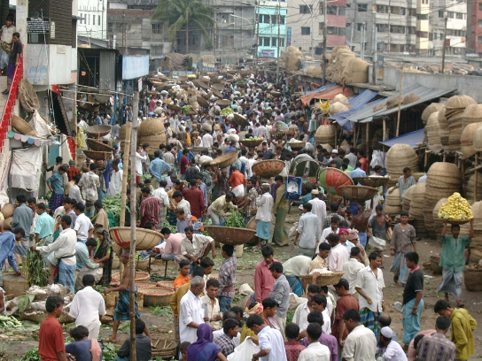
Tourist have…
Differing abilities to enter strange places, based on their
  Personal, social, psychological make up
Different interest in doing so due to
  Travel motives, trip purposes
Different structural abilities due to
  Families, travel partners, etc
If ‘risk’ is too high, they will not visit
Photograph by McKercher

Slide 9
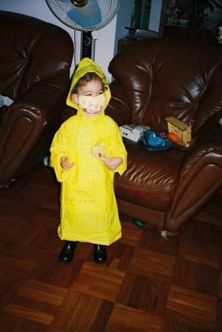
How to Cope: environmental bubble
People want to experience change from the security of their own environmental bubble
What is it?
  Bubble of familiarity that reduces strangeness to acceptable levels
  Physical or psychological ‘safety blanket’ that enables to experience strangeness but not be overly threatened by it
Photograph by McKercher

Slide 10
Why
Most travelers are not adventuresome drifters
  Most do not want to feel that they are facing real risks and real discomfort in pursuit of their vacation
Market dictates the types of services and amenities demanded
  Vast majority of travelers are looking for comfort and demanding some sort of environmental bubble
But, still want to have a novel experience
  Consumers seek a break, an escape from their normal life
Mass tourism is an industry that works most efficiently when products can be standardised, packaged, mass produced and easily consumed

Slide 11
Four types of tourist and their bubble needs
Classification | Type | Bubble needs
Institutionalised tourist | Organised Mass Tourist | Least adventurous and remains largely confined to an "environmental bubble" Stays almost exclusively in the microenvironment of his home country. Familiarity is at a maximum, novelty at a minimum
 | Individual Mass Tourist | Similar to above, but independent Experiences from within the "environmental bubble" of home country Familiarity is still dominant, but somewhat less so
Non-institutionalised tourist | Explorer | Tries to get off the beaten track but looks for comfortable accommodations Tries to associate with locals Can step back into real world when the going becomes too rough Novelty dominates, tourist does not immerse completely
 | Drifter | Ventures furthest from the accustomed ways of life of home country Tries to live the way the locals do No fixed itinerary or timetable Almost wholly immersed in their host culture

Slide 12
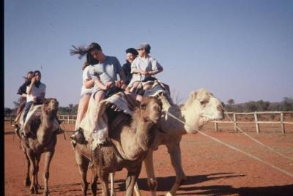
Tourists want the experience controlled
Why?
Once in a lifetime visit
Limited time and want to see highlight
See value adding in controlling experience
Photograph by McKercher

Slide 13
How/why industry delivers it?
Efficiencies can be achieved when the product can be standardised, packaged, mass produced and easily consumed
Tourist's experience ordered, predictable and controllable as much as possible
Enables tourists to take in the novelty of the area without any physical or emotional discomfort.
Can charge a fee for these products
Broaden market by:
  Reducing skill level required to participate
  Reducing cultural distance
  Making consumption easier
  Enhancing fun and learning
  Enhancing consumption

Slide 14
Value adding as a synonym for environmental bubble?
The whole basis of the tourism industry
From industry perspective creating the environmental bubble adds value that lets industry charge for its goods and services
Commercial tourism is the business of strangeness reduction
People pay more for the bubble than the physical product

Slide 15
Cohen (1979) and the ‘Centre and the Other’
Every society possesses a centre, which is its ultimate moral value
  Represents the paramount symbols of a society, be they social, cultural or religious
But, most people in modern and post-modern societies are not centred, and indeed, are alienated
  Tourism becomes an opportunity to look for their Centre, or to reconnect with the Centre they have become alienated from

Slide 16
Five roles tourists play depending on the trip
Recreational – basically well grounded in their life
  Tourism is a move away from the Centre that eventually reinforces it
  Travel to re-create, recharge batteries
Diversionary – essentially alienated from their home culture
  Seek a temporary escape from their boring and meaningless routine
  Goal is to heal the body and sooth the spirit but not to re-create
Experiential – on a quest for short duration authentic experiences
  Try to break the bonds of their everyday existence and begin to live
  Tourism absorbs the social function of religion by trying to experience other cultures
Experimental - actively go on a quest for Centres in other societies
  Seek authentic life and lifestyle in other cultures, but do not fully commit to them
Existential – seek different Centres,
  Fully commit themselves to it

Slide 17
Anthropological perspective - tourism as a liminal experience
Tourism involves a journey away, a stay at some distant location and a return journey home
But, more than the physical act of traveling
  Involves both geographical and symbolic separation from one’s home
  Tourism is imbued with many meanings, where the act of becoming and then being a tourist is associated with a temporary psychological and emotional metamorphosis of disassociation from the normal
Tourism likened to a liminal experience, where people experience communitas upon entering a liminoid landscape
  A liminal state refers to a temporary transitional state between more permanent states where the person lacks social status and structure
  Profane social relations may be discontinued, formal rights and obligations are suspended and the social order may have been turned upside down.

Slide 18
Liminality
A betwixt and between state where the person is understood to be ‘no longer’ and simultaneously ‘not yet’
  Example - teenage years, where the person is no longer a child and simultaneously not yet an adult
Liminal spaces provide two types of freedom
  Freedom from institutional obligations, and
  Freedom to play with ideas, with fantasies, with words
Liminal phase is simultaneously destructive and constructive
  A time when social structures are inverted
  Individuals are encouraged to question tacit knowledge

Slide 19
Liminality has 3 stages
  Separation
    Stripped of the social status that he or she possessed before
  Liminal period
    Inducted into the liminal period of transition, where they have no status
    They are betwixt and between the positions assigned and arrayed by law, custom, convention, and ceremony
    Status is socially and structurally ambiguous
  Re-assimilation
    Given his or her new status and re-assimilated

Slide 20
Travelling represents:
A journey to and from
An escape, spatially, temporally, socially and psychologically from one’s normal existence
  Spatial – journey away, stay, journey back
  Temporal (time) – escape from work
  Social/Psychological – escape from everyday work, social and other pressures
Re-integration back into one’s life

Slide 21
Nature of Tourism (Jafari 1987)
Animation
‘Inhabit non-ordinary space and time’
Emancipation / escape
Repatriation
Need / desire to leave ordinary behind
Return to the ordinary

Slide 22
Need / desire to leave ordinary behind
‘Ordinary’ life typified by
  Mundane, daily life
  Long periods of time
  Regular rhythm
Stresses and pressures of everyday life
  Creates ‘Need to get away from it all”
Action - begins to think about the trip, collect information, buy tickets, etc.

Slide 23
Emancipation / escape
Action – Journey away
2 Processes
  Separation
    Physical, psychological
      Create real and emotional distance between home and ordinary life
  Declaration or entry into touristhood
    Emancipation or freedom
      Crossing/ leaving the home sociocultural norm
    Change identity of traveller
        Anonymous mask of the tourist in a strange land
        Enter new, temporary lifestyle where different social norms apply
        Leaves his or her identity and becomes a ‘tourist’

Slide 24
Animation - inhabit non-ordinary space and time
‘As immersion into touristhood deepens, the tourist realises he/she is no longer imprisoned by his former self but is transformed into a new person with a new identity (the tourist), that he is playing on a new stage (the destination) (Jafari 1987)
Living up to the rhythm of a new culture (the tourist culture)
‘Ordinary’ relegated to residual culture
  Depending on how far one leaves can shed residual culture partly or fully
‘Non-ordinary’ becomes new reality
Progressive peeling away homebound cultural layers until the individual is detached enough to let go

Slide 25
Repatriation
Action – begin journey back
Process of leaving the non-ordinary and rejoining the ordinary
  Spatial
    Leave the destination and return home
  Psychological
    Leave the freedom and return to structured life
    Reconnect to core residual culture
    Prepare to return to work, etc

